Slide 1

PRIYAM SHARMA (202410116100152) SATYJEET KUMAR (202410116100187) SAURABH KUMAR (202410116100188)
Introduction To AI (AI101B)
Even Semester
Session 2024-25
TOPIC- Sentiment Analysis of Movie Reviews

Slide 2
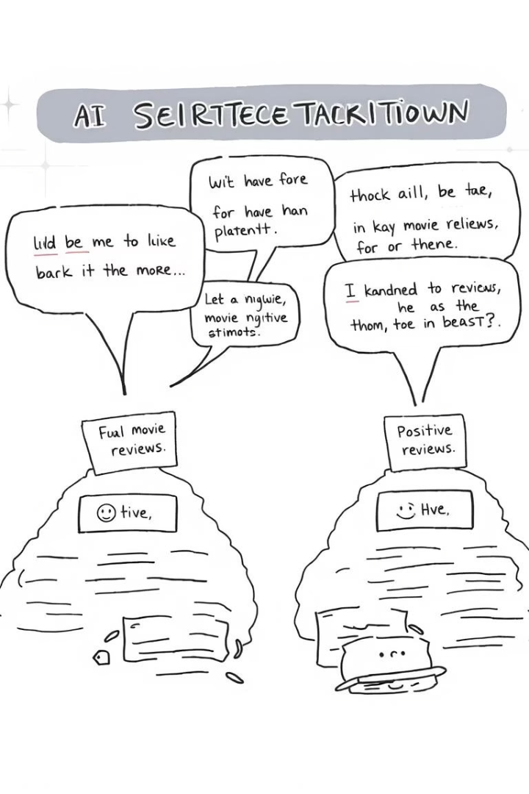
Sentiment Analysis of Movie Reviews
This presentation explores our project on sentiment analysis of movie reviews, developed to automatically classify film reviews as positive or negative. In today's digital age, people frequently share their opinions about movies online, making it challenging to read through thousands of reviews manually. Our system uses text processing and machine learning to analyze these reviews efficiently, helping users understand public perception without reading individual reviews.

Slide 3




Project Overview
Primary Objective
Target Beneficiaries
Facilitate understanding of public perception about movies without reading all reviews manually
Ordinary users, filmmakers, critics, and review-dependent websites
Technical Approach
Simple text processing and machine learning methods to classify reviews as positive or negative

Slide 4
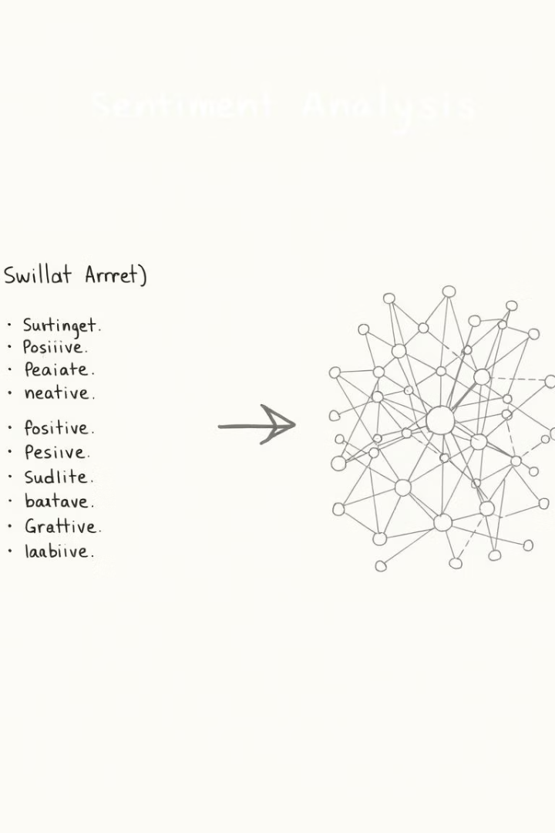



Literature Review
Lexicon-Based Techniques
Early approaches using predefined positive/negative words to determine sentiment, with limitations in detecting sarcasm
Machine Learning Approaches
Pang et al. (2002) demonstrated that models like SVM and Naive Bayes outperform lexicon-based approaches by detecting patterns
Deep Learning Methods
CNN and LSTM networks discover intricate patterns and context within reviews, with Zhang et al. (2018) showing better performance with big data

Slide 5
Project Objectives
Technical Goals
Research Goals
Create an automatic movie review classification system
Compare sentiment analysis models on issues like sarcasm
Enhance efficiency in processing large amounts of reviews
Discuss binary and multiclass sentiment classification
Utilize contemporary machine learning and deep learning methods
Evaluate popular datasets (IMDb, Rotten Tomatoes)

Slide 6





Project Methodology
Data Collection
Collect movie reviews from sites such as IMDb or Rotten Tomatoes
Data Preprocessing
Clean data by removing HTML tags, URLs, special characters; perform tokenization
Feature Extraction
Transform text into numerical data using TF-IDF or word embeddings
Model Training & Evaluation
Train models (Naive Bayes, SVM, LSTM, CNN) and assess performance using accuracy metrics

Slide 7
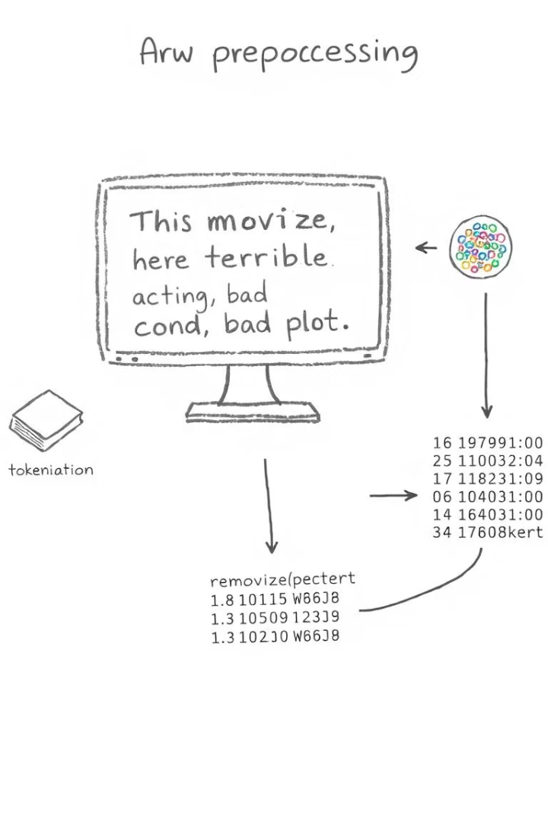
Data Preprocessing
Text Cleaning
Remove HTML tags using BeautifulSoup, eliminate URLs and special characters with regular expressions, and convert text to a standardized format
Tokenization
Use spaCy to break text into tokens, remove stop words, apply lemmatization, and keep only adjectives, nouns, and verbs to reduce vocabulary size
Feature Extraction
Convert text to numerical vectors using Bag-of-Words (BoW) and Term Frequency-Inverse Document Frequency (TF-IDF) techniques

Slide 8
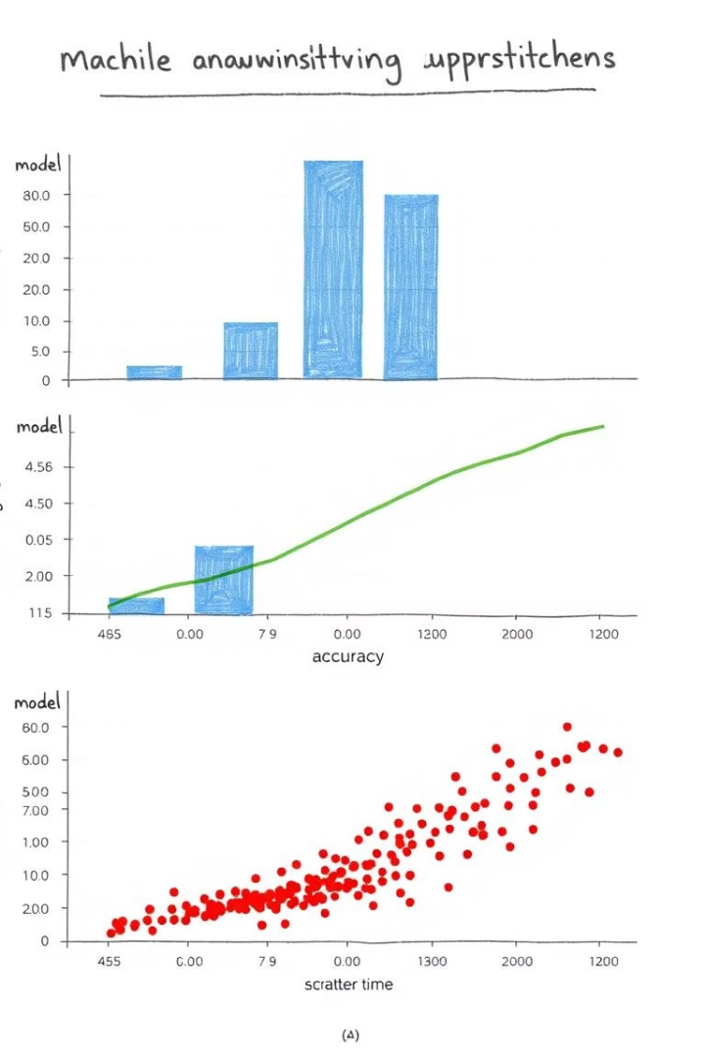
Model Implementation
Naive Bayes
Logistic Regression
Implemented with both BoW and TF-IDF vectors, tuning the alpha parameter using grid search. Achieved 85% accuracy with both vectorization methods.
Applied with L1 and L2 regularization, tuning the C parameter. Achieved 88% accuracy, outperforming Naive Bayes on both BoW and TF-IDF vectors.
Deep Learning Models
Implemented LSTM and CNN models that performed significantly better than traditional models, especially with complex sentences and mixed emotions.

Slide 9
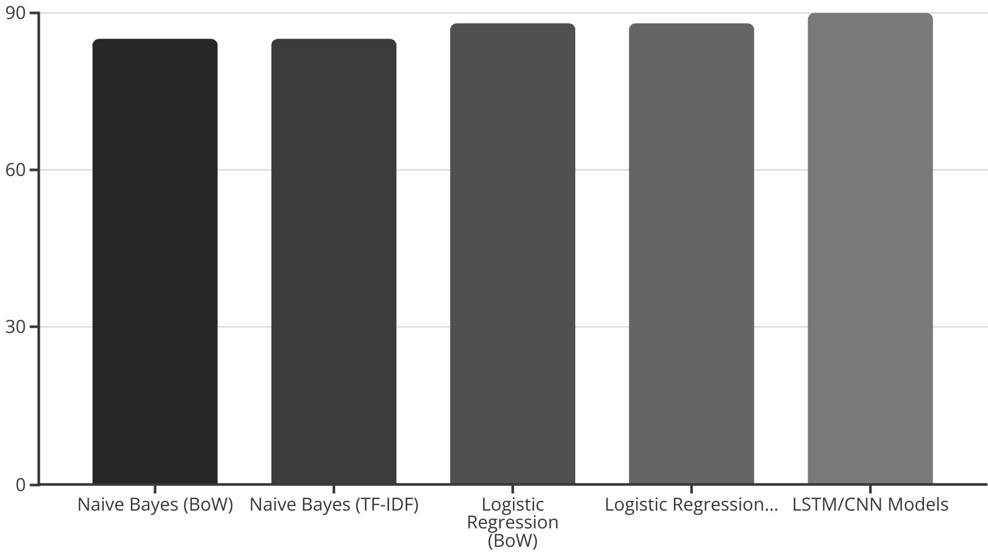
Results and Performance
Our models achieved high accuracy rates, with deep learning models performing the best at 90%. Logistic Regression outperformed Naive Bayes, while TF-IDF and BoW vectorization showed similar results. The models successfully handled complex emotions, sarcasm, and domain-specific language, providing real-time insights from large datasets.

Slide 10








Project Outcomes
High Accuracy
Complex Emotion Handling
Achieved over 85% accuracy in classifying movie reviews
Successfully identified sarcasm and contradictory emotions
Scalability
Real-Time Insights
Performed well with large datasets like IMDb and Rotten Tomatoes
Analyzed large volumes of reviews quickly

Slide 11



Conclusion and Future Work
Demonstrated AI Value
Showed how AI can simplify decision-making through automatic opinion classification
Broad Applications
Benefits ordinary users, filmmakers, critics, and review websites
Future Enhancements
Potential for multiclass sentiment, aspect-based analysis, and emotion detection

